Slide 1
PSCS224 - Customer Support Chatbot with ML
PIP2001 Capstone Project
Review-0
Batch Number: CST G-01
Under the Supervision of,
Dr. Saravanan
Assistant Professor
School of Computer Science and Engineering
Presidency University
Roll Number | Student Name
20211CST0024 | Mohammed Rahim
20211CST0017 | Ronuru Mukesh
20211CST0005 | Saribala Vinay Kumar Reddy
20211CST0016 | Rampalli Jagan Mohan
Name of the Program: Computer Science and Technology(AIML)
Name of the HoD: Dr. Saira Banu
Name of the Program Project Coordinator: Dr. H M MANJULA
Name of the School Project Coordinators: Dr. Sampath A K / Dr. Abdul Khadar A / Mr. Md Ziaur
Rahman

Slide 2
Content
Problem Statement
Analysis of Problem Statement
Timeline of the Project
References
Github: https://github.com/MohdRahim91

Slide 3
Problem Statement Number:
Organization: KG Info Systems Pvt Ltd
Category : Software
Problem Description: A customer support system that is easily and readily available is essential for any customer oriented business. In general, it can be observed that people want their problems to be addressed quickly and efficiently. We would like to build an online natural language chatbot platform which would address queries put forth to it in natural language. By extracting the issue at hand from a particular query, the platform would then find the solution in a pre-existing database. It would then guide the customer, step by step, on how to solve his problem in the most effective way possible. A customer would be able to easily use the support chatbot rather than having to directly talk to a customer care executive.
Difficulty Level: Medium

Slide 4
Analysis of Problem Statement
Technology Stack Components:
Frontend:
HTML, CSS, javascript, Bootstrap, jQuery, Web Speech API, Google Cloud text to speech, botUI.
Backend :
Flask, PyTorch, Natural Language Toolkit, SpaCy, Rasa NLU, Python, Database, Translate API

Slide 5
Analysis of Problem Statement (contd...)
Software Requirements:
VS Studio
Jupiter
Google Colab
Rasa NLU

Slide 6
Analysis of Problem Statement (contd...)
Objective: Provide quick, efficient, 24/7 customer support using
natural language processing.
Key Features:
Query extraction and solution matching from a pre-existing database.
Multi-language support for global accessibility.
Text-to-speech functionality for vocal input.
Benefits:
Reduces wait times and call center workload.
Provides human-like, step-by-step guidance.
Simplifies issue resolution for customers.

Slide 7
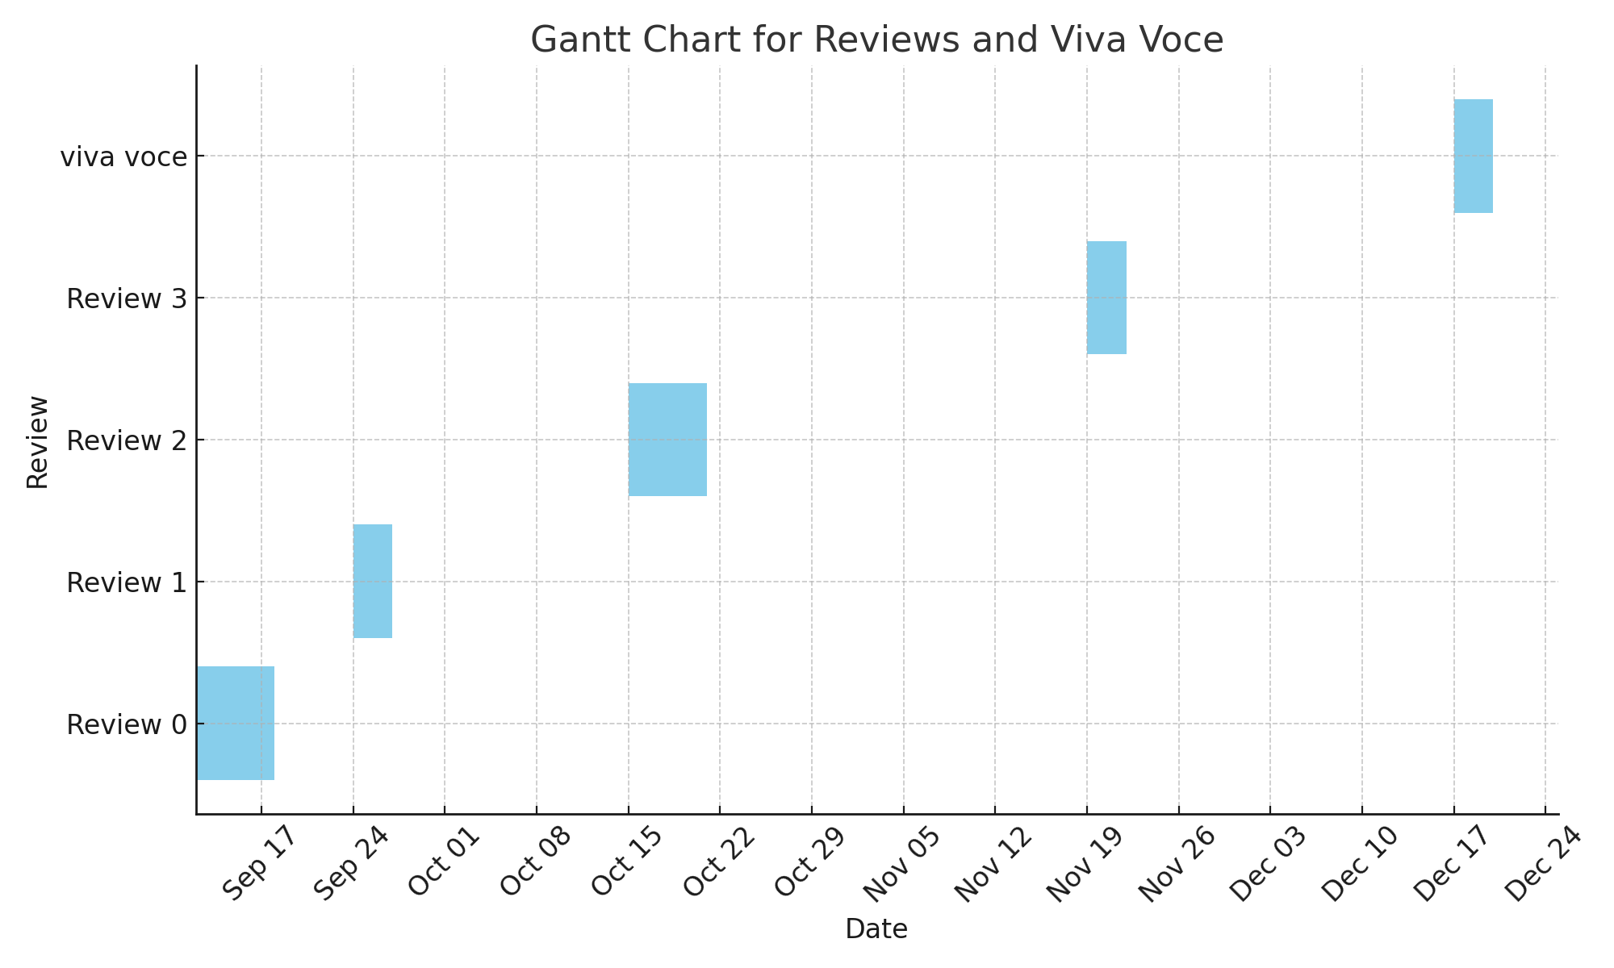
PROJECT TIME LINE

Slide 8
References (IEEE Paper format)
Research paper on customer support chatbot with machine learning by [International Research Journal of Engineering and Technology (IRJET)]done by presidency university students
https://www.kommunicate.io/blog/create-a-customer-service-chatbot-using-chatgpt/
https://seayeshaiftikhar.medium.com/customer-support-chatbot-using-python-168e0a7c958d#:~:text=Overall%2C%20this%20project%20provides%20a%20solid%20foundation,learning%2C%20and%20Flutter%20for%20modern%20software%20development

Slide 9


